Slide 1
Antialiasing
Antialiasing is a technique used in computer graphics to remove the aliasing effect. The aliasing effect is the appearance of jagged edges or “jaggies” in a rasterized image (an image rendered using pixels). The problem of jagged edges technically occurs due to distortion of the image when scan conversion is done with sampling at a low frequency, which is also known as Undersampling. Aliasing occurs when real-world objects which comprise smooth, continuous curves are rasterized using pixels. The cause of anti-aliasing is Undersampling.
Anti-aliasing works by smoothing out these edges, making the image appear more realistic and visually appealing

Slide 2
Under sampling results in a loss of information about the picture. Under sampling occurs when sampling is done at a frequency lower than the Nyquist Sampling Frequency. To avoid this loss, we need to have our sampling frequency at least twice that of the highest frequency occurring in the object.
This minimum required frequency is referred to as Nyquist sampling frequency (fs). It can be stated as:
f_{s} =2*f_{max}

Slide 3
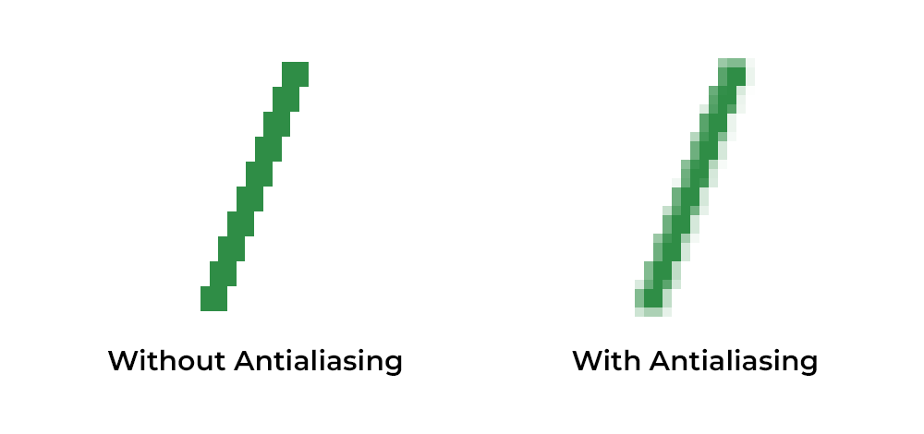

Slide 4
Methods of Anti-Aliasing (AA)
There are four methods of Anti-Aliasing. These methods are mentioned below.
High-Resolution Display
Post-Filtering
Pre-Filtering
Pixel Phasing

Slide 5
1. Using High-Resolution Display
One way to reduce the aliasing effect and increase the sampling rate is to simply display objects at a higher resolution. Using high resolution, the jaggies become so small that they become indistinguishable from the human eye. Hence, jagged edges get blurred out and edges appear smooth.
Practical applications: For example, retina displays in Apple devices, and OLED displays have high pixel density due to which jaggies formed are so small that they blurred and are indistinguishable by our eyes.

Slide 6
2. Post Filtering (Supersampling)
In this method, we are increasing the sampling resolution by treating the screen as if it’s made of a much more fine grid, due to which the effective pixel size is reduced. But the screen resolution remains the same. Now, intensity from each subpixel is calculated and the average intensity of the pixel is found from the average of intensities of subpixels. Thus we do sampling at a higher resolution and display the image at a lower resolution or resolution of the screen, hence this technique is called supersampling. This method is also known as post filtration as this procedure is done after generating the rasterized image.
Practical Applications: In gaming, SSAA (Supersample Antialiasing) or FSAA (Full-Scene Antialiasing) is used to create the best image quality. It is often called pure AA and hence is very slow and has a very high computational cost.

Slide 7
3. Pre-Filtering (Area Sampling)
In area sampling, pixel intensities are calculated proportionally to areas of overlap of each pixel with objects to be displayed. Here pixel color is computed based on the overlap of the scene’s objects with a pixel area.
Example: Suppose, a line passes through two pixels. The pixel covering a bigger portion(90%) of the line displays 90% intensity while less area(10%) covering the pixel displays 10-15% intensity. If the pixel area overlaps with different color areas, then the final pixel color is taken as an average of colors of the overlap area. This method is also known as pre-filtering as this procedure is done BEFORE generating the rasterized image. It’s done using some graphics primitive algorithms.

Slide 8
4. Pixel Phasing
It’s a technique to remove aliasing. Here pixel positions are shifted to nearly approximate positions near object geometry. Some systems allow the size of individual pixels to be adjusted for distributing intensities which is helpful in pixel phasing.

Slide 9
Types of Anti-Aliasing
Anti-Aliasing can be broadly classified into two broad categories.
Spatial Anti-Aliasing: Spatial Anti-Aliasing is a technique that is used in cases when a low-resolution picture has jaggies. It is used to minimize the distortion effects upon the representation of the higher image to a lower image. These are classified as:
Super Sampling Anti-Aliasing
Multi-Sample Anti-Aliasing
Post-Process Anti-Aliasing: Post-Processing Anti-Aliasing is a technique used when every process is blurred in the rendering processing. It is a quicker technique in comparison to Spatial Anti-Aliasing. It is of the following types:
Temporal AntiAliasing
Enhanced Subpixel Morphological Antialiasing

Slide 10
Image resizing
Image resizing refers to the scaling of images.
It helps in reducing the number of pixels from an image and that has several advantages e.g. It can reduce the time of training of a neural network as the more the number of pixels in an image more is the number of input nodes that in turn increases the complexity of the model. It also helps in zooming in on images.
Many times we need to resize the image i.e. either shrink it or scale it up to meet the size requirements.
OpenCV provides us several interpolation methods for resizing an image

Slide 11
Choice of Interpolation Method for Resizing:
cv2.INTER_AREA: This is used when we need to shrink an image.
cv2.INTER_CUBIC: This is slow but more efficient.
cv2.INTER_LINEAR: This is primarily used when zooming is required. This is the default interpolation technique in OpenCV.

Slide 12
Syntax: cv2.resize(source, dsize, dest, fx, fy, interpolation)
Parameters:
source: Input Image array (Single-channel, 8-bit or floating-point)
dsize: Size of the output array
dest: Output array (Similar to the dimensions and type of Input image array) [optional]
fx: Scale factor along the horizontal axis [optional]
fy: Scale factor along the vertical axis [optional]
interpolation: One of the above interpolation methods [optional]

